Slide 1
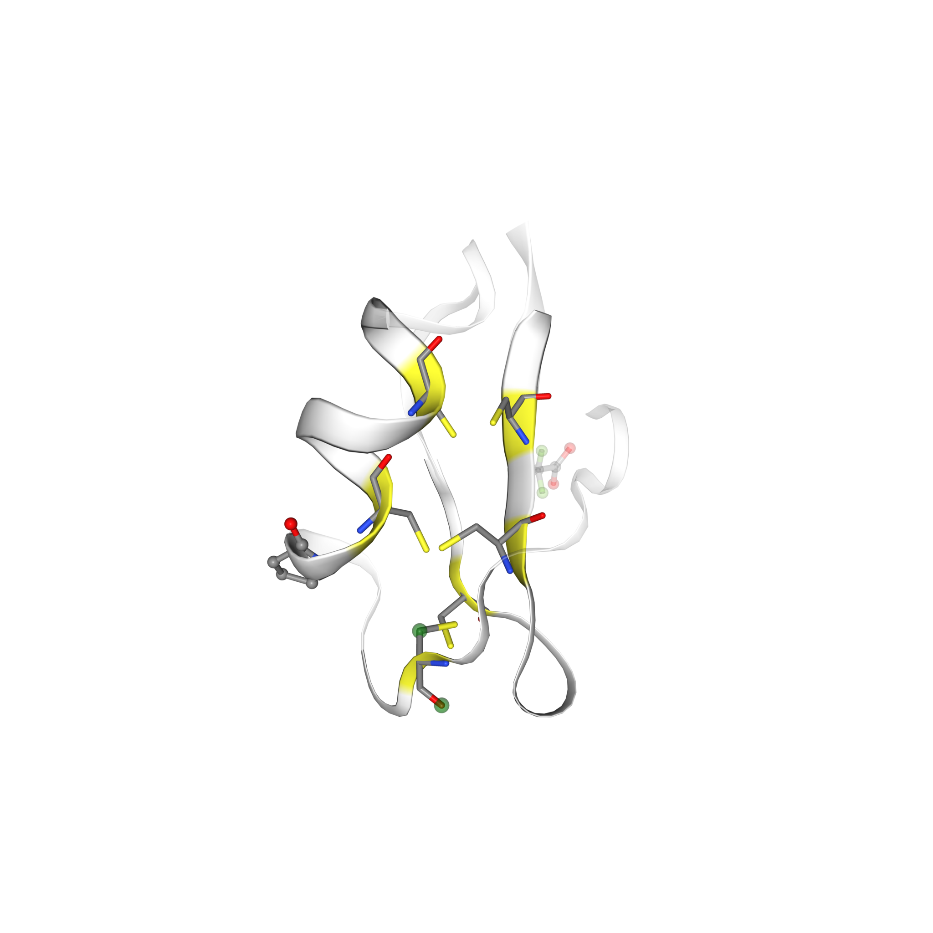
Predictive Analysis of protein structures: Parsing PDB data for Structural and Sequential Insight and Active Site Prediction in Protein-Protein Interaction at residue level
Submitted by
Godhuli Das
Examination Roll: M6TCT24023
Registration No:160099 of 2021 – 2024
Class Roll: 02110504028
Under the guidance of
Prof. (Dr.) Subhadip Basu
DEPARTMENT OF COMPUTER SCIENCE AND ENGINEERING, JADAVPUR UNIVERSITY

Slide 2
Outline
1. Introduction
2. Literature Review
3. Research Objectives
4. Proposed Methodology
5. Detailed Discussion
6. Experiments and Evaluation
7. Conclusions and Future Work
8. References

Slide 3
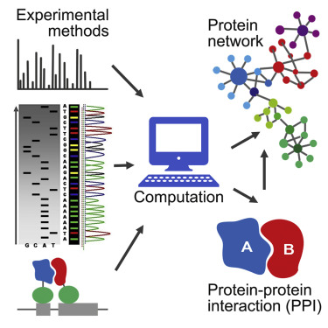
Introduction
Computational methods and deep learning technologies have shown great promise in predicting active sites in protein complexes. Recent studies have demonstrated the efficacy of these approaches, but challenges remain, including the need for improved interpretability, scalability, and generalization across diverse protein structures.
To address these challenges, future research may focus on advancing model architectures, integrating data from multiple sources, and developing new algorithmic innovations.
The integration of computational methodologies and deep learning technologies offers promising avenues for accelerating drug discovery and protein engineering endeavours.
Finally, the use of trusted PDB data from RCSB PDB and the incorporation of both structural and sequential information can improve the accuracy of active site prediction structures.

Slide 4
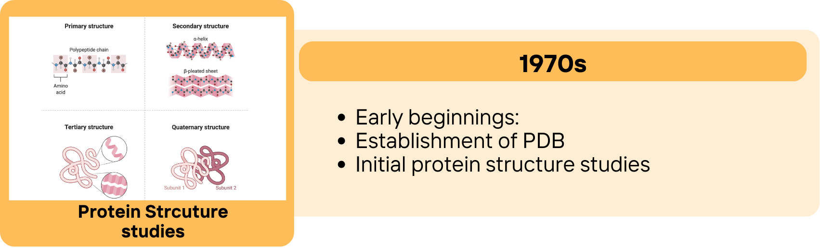
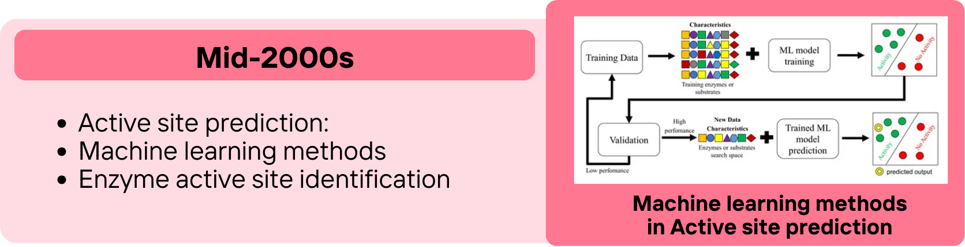
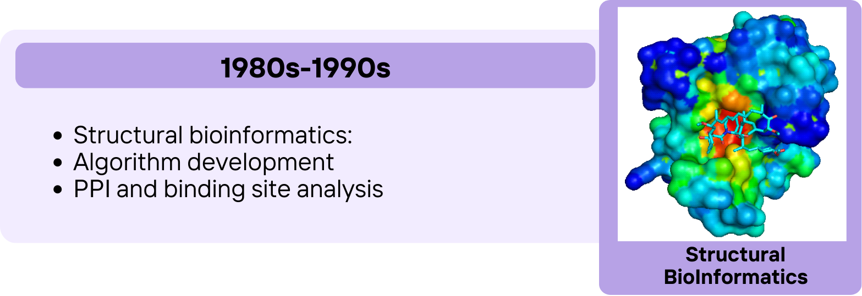
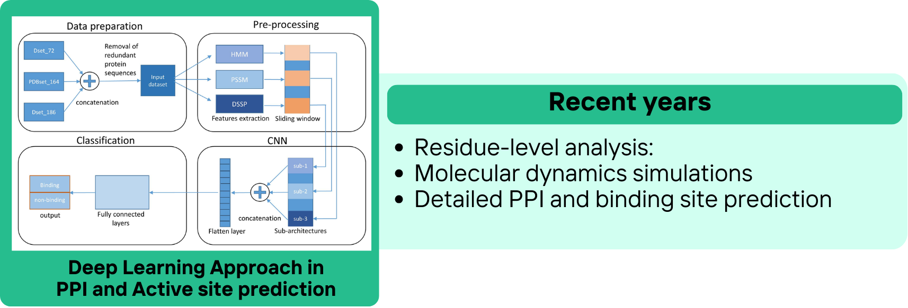
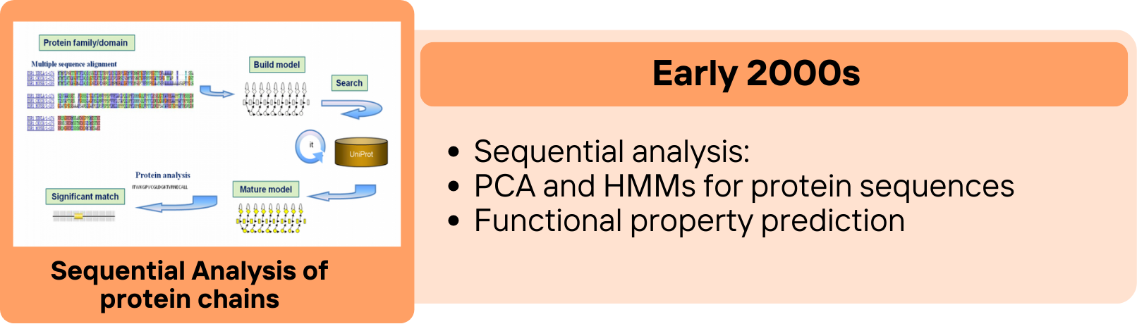
Literature Review

Slide 5
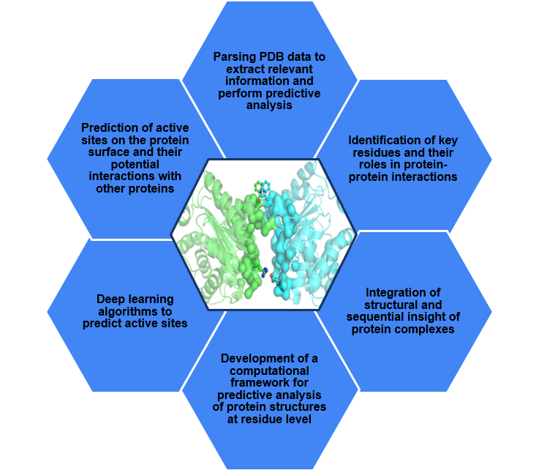
Research Objectives

Slide 6
Proposed Methodology
Predictive Analysis from protein structure information
A statistical analysis on interatomic distances between protein chains within individual protein complexes is computationally performed at residue level. This generates Positive PPI dataset (Gold dataset : distance < 5 Å), Silver dataset - 5 Å ≤ distance ≤ 10 Å) and Negative PPI dataset (non-interacting protein dataset - distance > 10 Å )
Visual Insight from protein structure information
Structural Information of protein complexes from PDB data
This is followed by computational generation of heatmaps to visually represent the proximity of active sites in protein-protein interactions.
PDB files are parsed to extract spatial location of “CA” atoms in protein complexes, followed by generating interatomic Euclidean distance matrices at the residue level.
Deep Learning Approach for Active Site Prediction
Sequential Information of protein complexes from PDB data
Sliding Window Approach for Sub-image Generation
The DensePPI model, utilizing the DenseNET 201 architecture, is employed for training and prediction. Performance metrics are evaluated based on the testing results.
PDB files are parsed to extract sequence information of unirpots in protein complexes. Images are generated from this by a colour encoding strategy that maps amino acids of protein chain to a lookup table.
Sub-images are generated using a sliding window method with dimensions of 32x32 and a stride of 2.

Slide 7
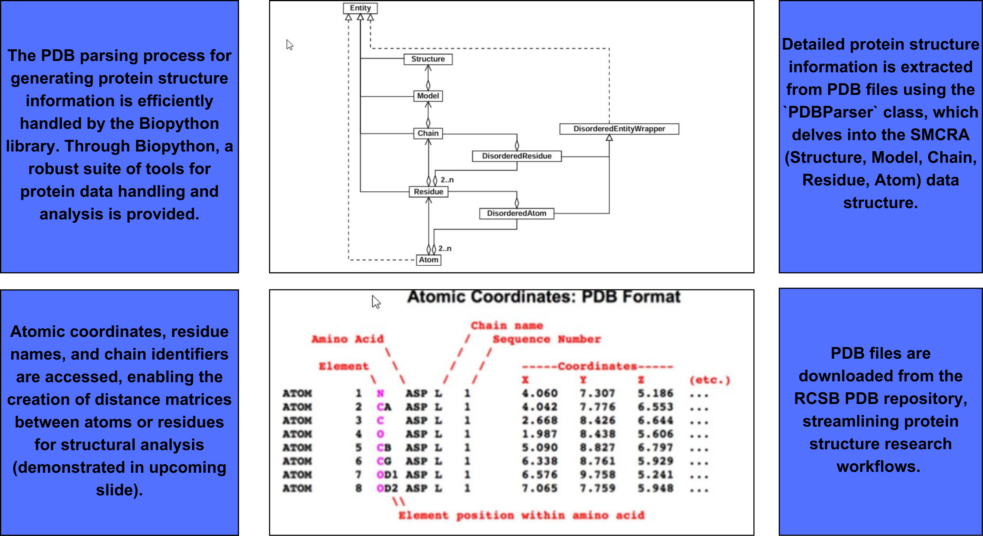
PDB Parsing for Protein Structure Information Generation by Biopython library

Slide 8
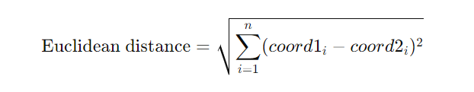
Pairwise Interatomic Distance Calculation of protein complexes and Matrix Generation
With the extracted structural information from PDB data parsed, pairwise distances between alpha carbon atoms (`CA`) of protein chains are calculated.
The specific function iterates over all possible combinations of protein chain pairs within each structure. For each pair, the Euclidean distance between corresponding alpha carbon coordinates is computed to construct a distance matrix. This matrix quantitatively represents the spatial separation between residues in the protein chains.

Slide 9
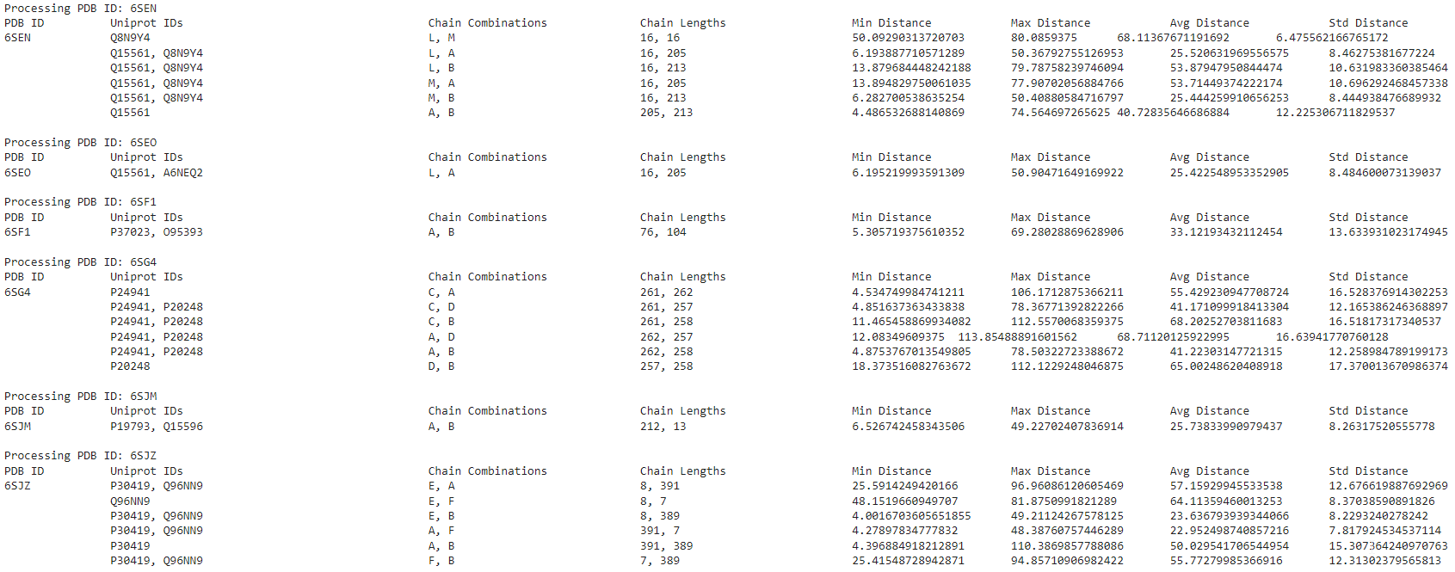
Quantitative Insights from PDB data parsed
Once the distances between protein chains are computed, various statistical measures are derived to characterize their spatial relationships. This process includes:
Computing minimum, maximum, average distances, and the standard deviation of distances.
Providing quantitative insights into the proximity and distribution of protein chains.
Facilitating the identification of key structural features and interaction patterns.
These steps offer a comprehensive understanding of the spatial relationships within protein structures.

Slide 10
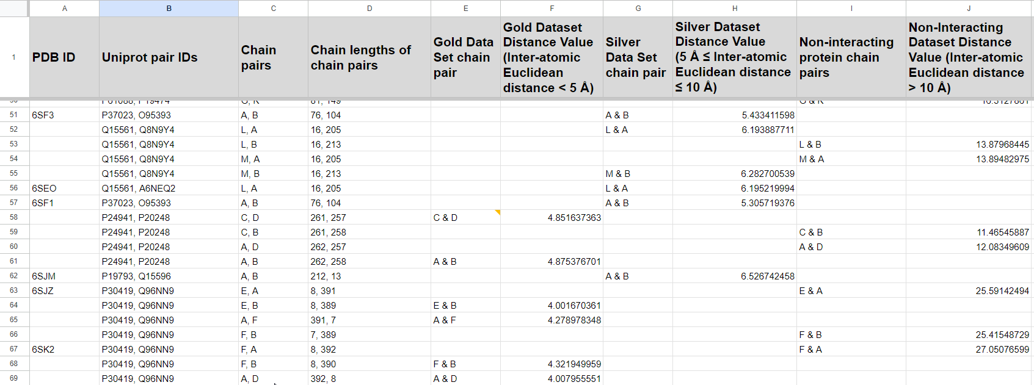
Predictive Analysis from PDB data parsed
The dataset summary is being prepared that includes euclidean distances between chain pairs based on the overall minimum distance thereby analysing a prediction on the interaction classifications as :
Positive PPI dataset (Gold dataset : distance < 5 Å), Silver dataset : 5 Å ≤ distance ≤ 10 Å) and Negative PPI dataset (non-interacting protein dataset : distance > 10 Å )
This computational
process,
supported by
functions to retrieve
UniProt IDs and chain
information from
mmCIF files, offers
valuable insights into
protein structural
characteristics.

Slide 11
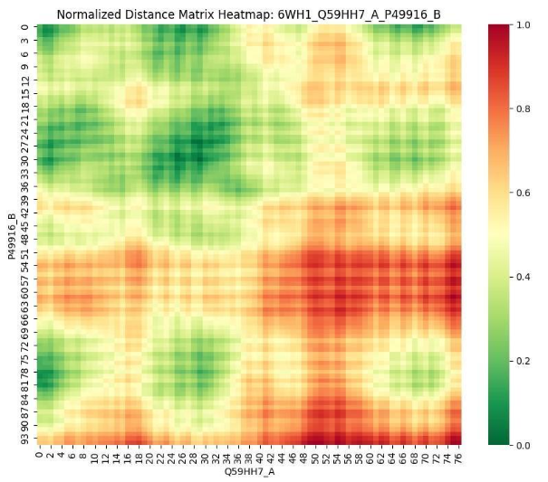
Visual Insight from Protein Structure Data by Heatmaps
For each pair of protein chains within a given structure, a distance matrix heatmap is generated using seaborn and matplotlib libraries.
The heatmap visualizes the distances between alpha carbon atoms, with a color gradient representing varying degrees of proximity. Specifically, the heatmap employs a color spectrum ranging from green (indicating shorter distance PPIs) to red (indicating longer distances PPIs), allowing for intuitive interpretation of spatial relationships within protein structures

Slide 12
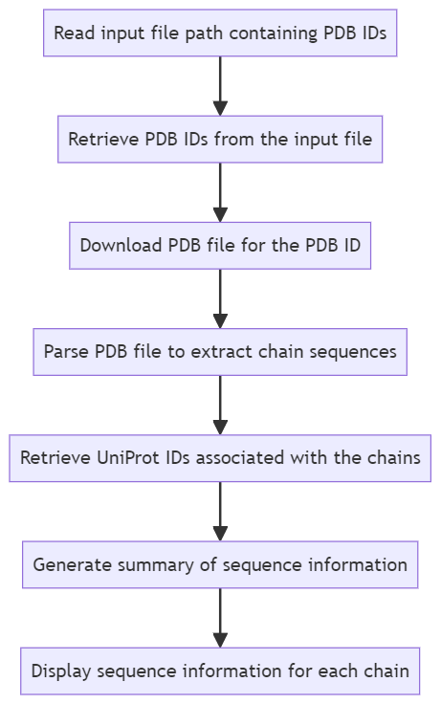
PDB Parsing for Protein Sequence Information Generation
Python script leverages Biopython package for the retrieval and analysis of protein sequences from the Protein Data Bank (PDB).
Aids in understanding primary protein structures, including amino acid sequences and associated UniProt IDs.
This protein sequence data facilitates downstream analyses (e.g., sequence alignment, functional annotation) for the current or other research in structural biology and bioinformatics.

Slide 13
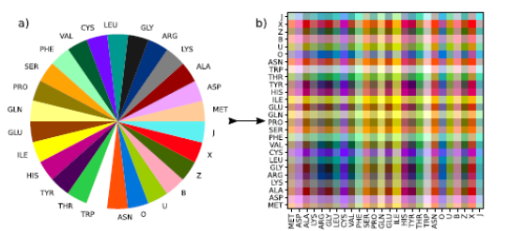
Image Generation from Protein Sequence Information
Bigram Interaction Mapping:
A color encoding strategy maps bigram interactions of amino acids to a lookup table, visualizing their interactions.
This method assigns each amino acid one of 26 distinct RGB colors, ensuring equal importance.
The resulting 26 × 26 color matrix (CMAP) represents residue interactions.

Slide 14
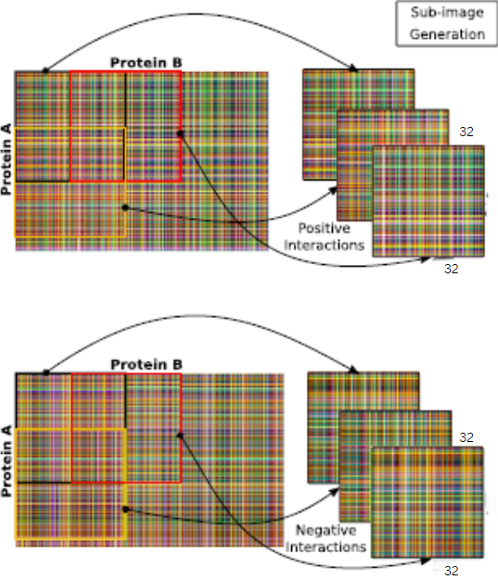
Sliding Window Approach for Sub-image Generation
Sliding Window Approach: A sliding window approach with fixed dimensions (32x32) and stride (2) is used to create sub-images from the original PPI images.
Sub-Image Generation for Training and Testing: The generated sub-images are categorized into positive and negative PPIs and are prepared for training and testing the model.

Slide 15
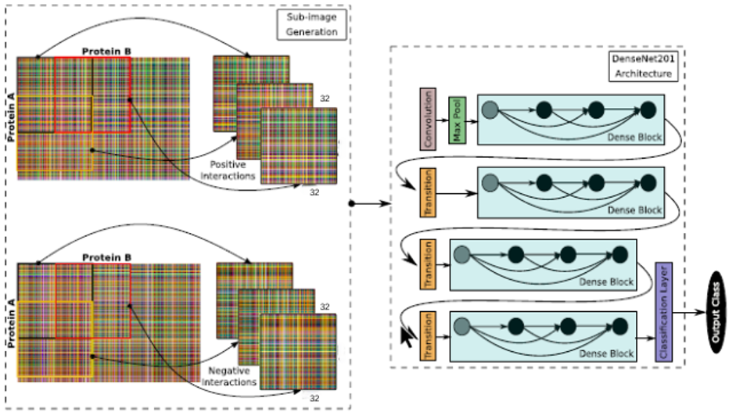
Training DensePPI model by Deep Learning Approach
The sub-images are processed by the DensePPI model, which incorporates the DenseNet 201 architecture. The DenseNet 201 architecture is depicted in next slide, showcasing its dense blocks, transition layers, and output layer.
Training Loop: The training loop iterates over
a specified number of epochs (10 in this case).
For each epoch, the model is set to training
mode and processes the training data in
batches. The optimizer updates the model
weights based on the computed gradients.
Confidence Score and Thresholding:
The classification strategy takes into account
the confidence scores for each sub-image.
A threshold of 0.5 is applied to determine the
final class label for the original PPI. For values >=0.5 are considered 1 hence, positive and
<0.5 considered 0, hence negative class.

Slide 16
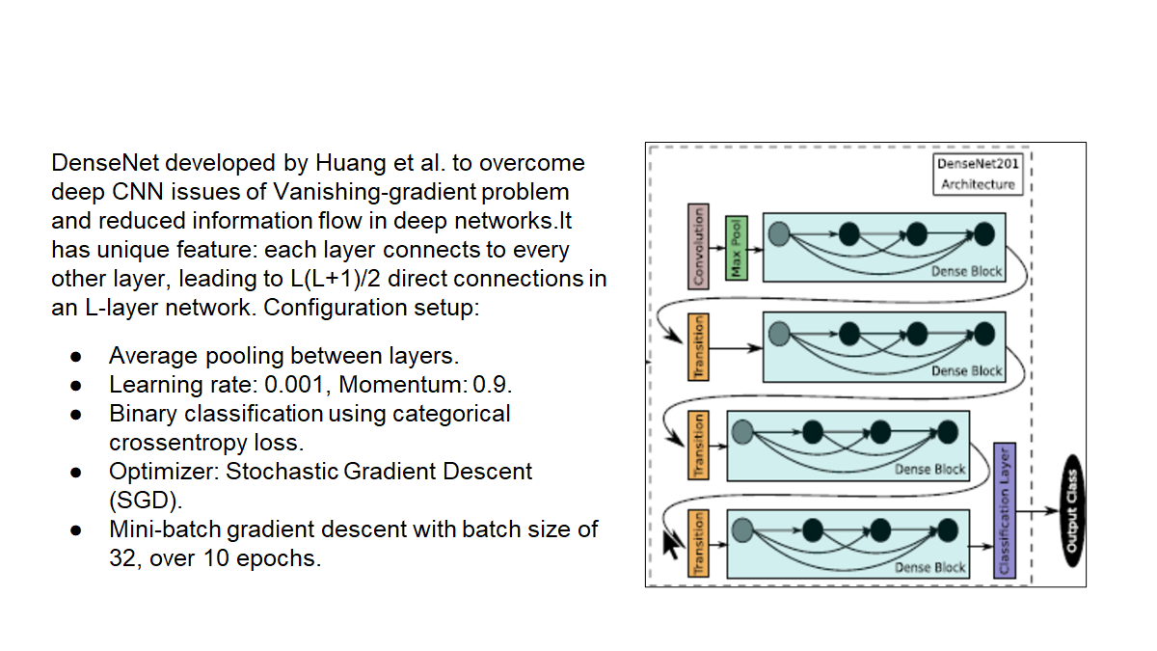
DenseNet 201 Architecture

Slide 17
Results and Discussions
Training and Testing Accuracy:
The training accuracy improved steadily over the epochs, starting from 84.83% in the first epoch and reaching up to 98.78% in the tenth epoch.
Training Loss:
The training loss consistently decreased over the epochs, starting from 0.3681 in the first epoch and reducing to 0.0277 by the tenth epoch. This indicates effective learning and convergence of the model.
Prediction Loss:
This is the loss calculated during the prediction phase of your model. It measures how well your model performs in terms of discrepancy between predicted and actual values. In this case, the prediction loss is 0.1414.
The testing accuracy achieved was 95.44%, indicating the model's ability to generalize well to unseen data.
Prediction Accuracy
This is the accuracy of your model's predictions on a test dataset. It measures the proportion of correctly classified instances out of the total instances. Here, the test accuracy is 0.95445, indicating that about 95.44% of the predictions were correct.

Slide 18
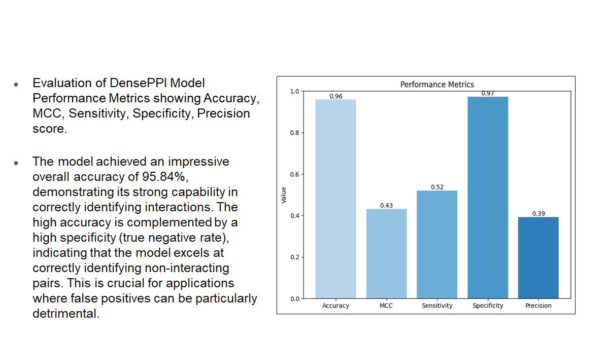
Evaluation Metrics

Slide 19
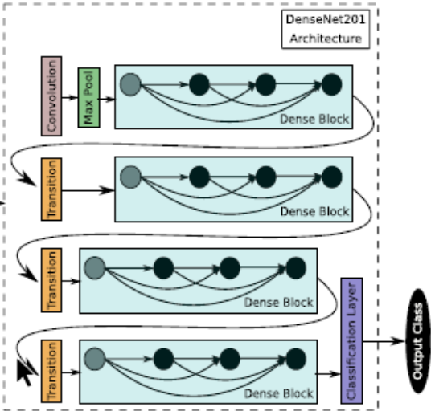
Overall Workflow diagram for Active site prediction in PPI at residue level
Structure information of (Positive PPI +Negative PPI) dataset prepared
Heatmaps generated based on PPI distance visualization colour spectrum for future validation purpose
Interatomic Distance Matrix of PPI at residue level in csv format
PDB Parsed Data
Sequence level information of protein chains
Sequence information of (Positive PPI +Negative PPI) dataset provided
Colour Encoding strategy to map Bigram Interaction of Amino Acid to the LookUp table
Sliding Window approach with fixed dimension and stride
PNG images generated for (Positive PPI +Negative PPI)
Prediction Evaluation and
Performance metric generation
Classification strategy based on confidence score -> [0,1] compared with threshold 0.5
Sub-images fed as input into DenseNet201 model for training and testing purpose
Sub-images generated for (Positive PPI +Negative PPI)

Slide 20
Conclusions
This study presents a comprehensive approach utilizing deep learning techniques, specifically the DenseNet 201 architecture, to identify residue-level interactions in protein complexes using a sample of PDB data for Homo sapiens species.
The methodology encompasses key processes such as novel dataset computation, alignment of multiple protein dataset parameters, model training, evaluation, and metrics generation. The model demonstrated robust performance, achieving an impressive overall accuracy of 95.84%. It excelled in accurately identifying non-interacting pairs, as evidenced by its high specificity, which is particularly crucial for applications where minimizing false positives is essential.
However, this deep learning approach for model training and prediction remains in the experimental phase and requires further research and experimentation, which is currently ongoing. Future improvements will be addressed in the upcoming slide.

Slide 21
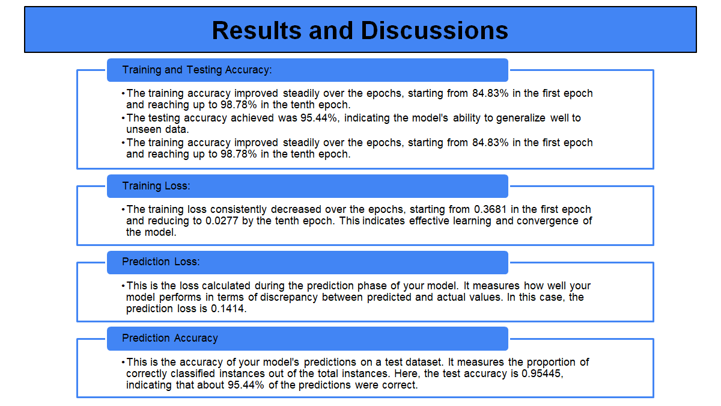
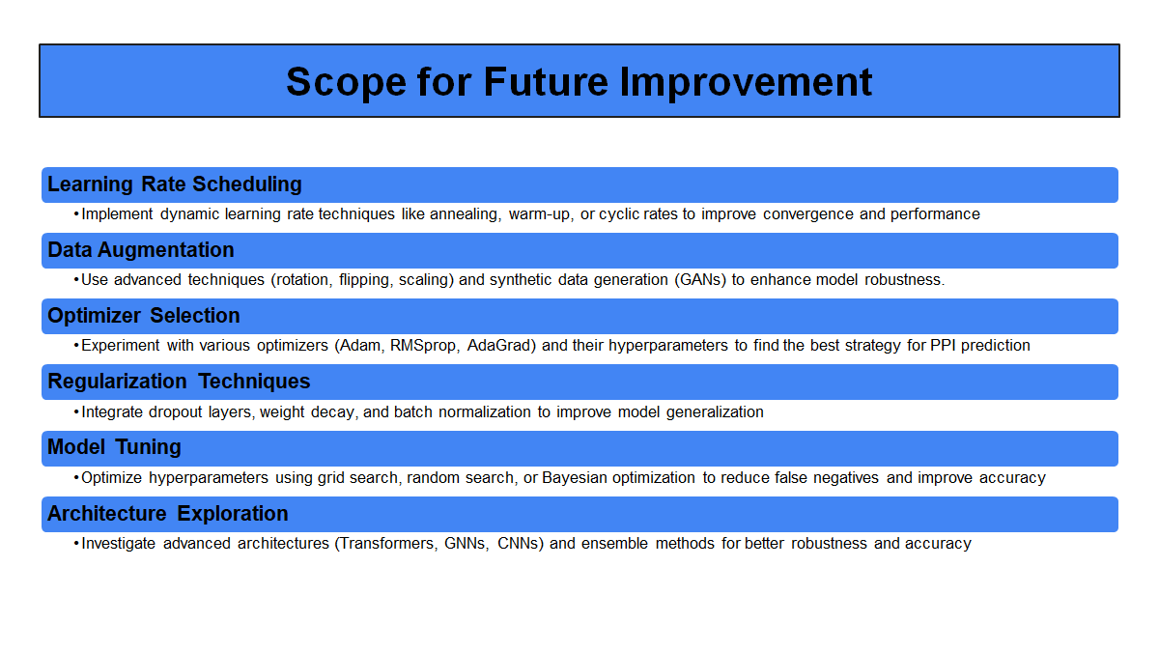
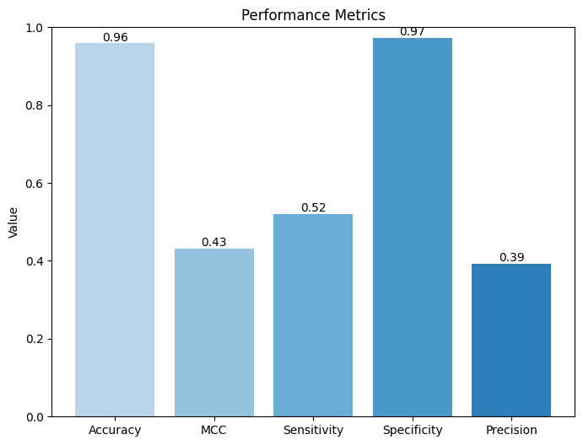
Evaluation Metrics
Evaluation of DensePPI Model Performance Metrics showing Accuracy, MCC, Sensitivity, Specificity, Precision score.
The model achieved an impressive overall accuracy of 95.84%, demonstrating its strong capability in correctly identifying interactions. The high accuracy is complemented by a high specificity (true negative rate), indicating that the model excels at correctly identifying non-interacting pairs. This is crucial for applications where false positives can be particularly detrimental.

Slide 22
References
Halsana, A.A., Chakroborty, T., Halder, A.K. and Basu, S., 2023. DensePPI: A Novel Image-based Deep Learning method for Prediction of Protein-Protein Interactions. IEEE Transactions on NanoBioscience.
Rose, P.W., Prlić, A., Altunkaya, A., Bi, C., Bradley, A.R., Christie, C.H., Costanzo, L.D., Duarte, J.M., Dutta, S., Feng, Z. and Green, R.K., 2016. The RCSB protein data bank: integrative view of protein, gene and 3D structural information. Nucleic acids research, p.gkw1000.
Hamelryck, T. and Manderick, B., 2003. PDB file parser and structure class implemented in Python. Bioinformatics, 19(17), pp.2308-2310.
Shen, J., Zhang, J., Luo, X., Zhu, W., Yu, K., Chen, K., Li, Y. and Jiang, H., 2007. Predicting protein–protein interactions based only on sequences information. Proceedings of the National Academy of Sciences, 104(11), pp.4337-4341.
Ballester, P.J. and Mitchell, J.B., 2010. A machine learning approach to predicting protein–ligand binding affinity with applications to molecular docking. Bioinformatics, 26(9), pp.1169-1175.
Zhao, J., Cao, Y. and Zhang, L., 2020. Exploring the computational methods for protein-ligand binding site prediction. Computational and structural biotechnology journal, 18, pp.417-426.

Slide 23
Thank you !
Any Questions ?

